Slide 1
IN THIS SECTION WE WILL DISCUSS: 1. WINDOWS 32 BIT AND 64 BIT SYSTEM. 2. CYBER SECURITY. 3.FDISK, FORMAT, SCANDISK, FAT SYSTEM, NTFS AND DIRECTORIES, FRAGMENTATION, DEFRAGMENTATION DISK.

Slide 2
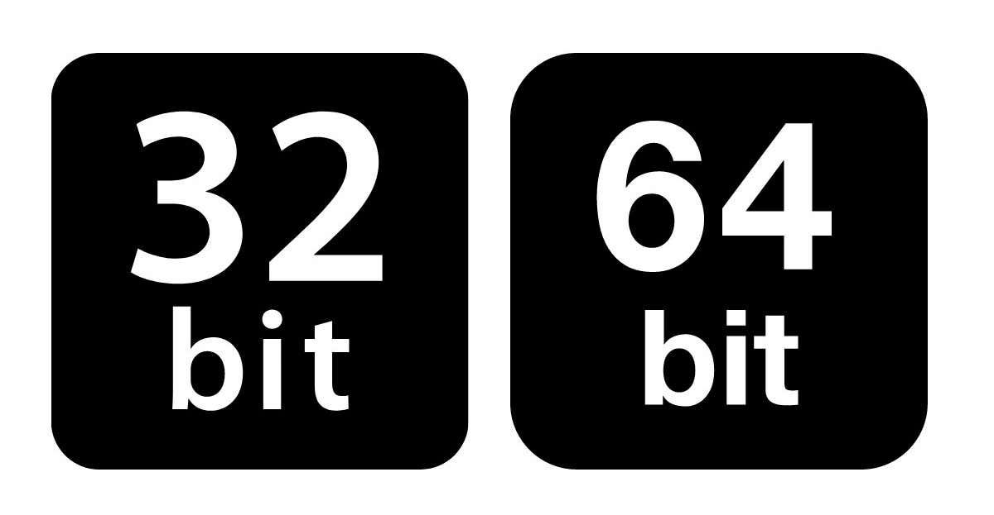
WINDOWS 32 BIT, AND 64 BIT SYSTEM

Slide 3
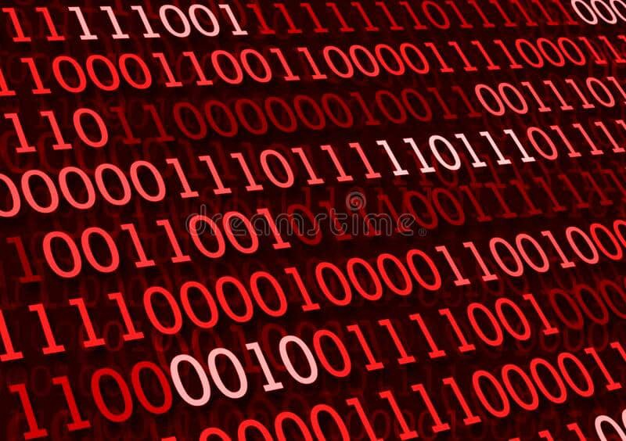
BIT
A bit is the smallest unit of data in a computer. It can have a binary value, that is either 0 and 1. the data storage, transmission, and processing depend on this basic unit. When there are more bits, the data processing happens in large chunks and is more accurate.

Slide 4
32 BIT
A 32 bit system is capable of transferring 32 bit data at a time. Thus a 32-bit processor can handle 32 bit binary numbers. Therefore the system breaks the data larger than 32 bits.
A hard disk is a permanent storage while RAM is a temporary storage. However, the data transferring rate of RAM is high. When the capacity of the RAM is high, the system can respond quickly to heavy loads.
A 32-bit system can point up to 2³² amounts of RAM. It is equivalent to 4GB. It may not be enough to hold all the data necessary for the computer to run faster. In this situation, the hard disk stores the additional data. Therefore, the data has to go to the hard disk as well. That can result in minimizing the speed of the computer.

Slide 5
64 BIT
A 64-bit system is a replacement for the 32-bit system. A 64-bit system is capable of transferring 64 bits at a time. It also refers to the width registers in the computer processor.
A 64-bit system can point up to 2⁶⁴ amounts of RAM. It is equivalent to 16 Exabytes, which is four times higher than 32 bits. As the 64-bit system can support more memory than 32 bit, it is possible to store more data into the RAM, instead of storing that on the hard drive. Because of this, the applications respond quickly, and the computer performs faster.

Slide 6
Processing Time
32 Bit: Requires more time to process and response.
64 Bit: Requires a minimum time to process and response.

Slide 7
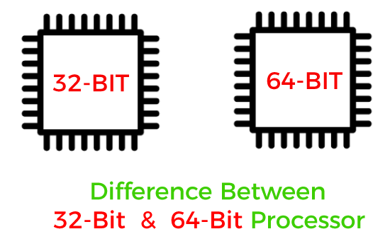
Difference Between 32 Bit and 64 Bit

Slide 8
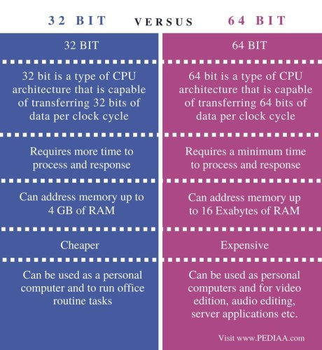

Slide 9
Usage
32 Bit: Used as a personal computer and to run routine office tasks.
64 Bit: Used as personal computers and for video editing, audio editing, server applications, etc.

Slide 10
Conclusion
Both 32 bit and 64 bit are CPU architectures that describe the data transferring rate. The difference between 32 Bit and 64 Bit is that a 32-bit system can address up to 4GB of RAM at a time while 64-bit system can address up to 16 Exabyte of RAM at a time. Overall, a 64-bit system is faster and can perform a high amount of computation than 32 bit. A 64-bit system also tends to have a most robust design with more registers and functional units.

Slide 11

Cyber Security

Slide 12
Cyber Security
Cyber security is the practice of defending computers, servers, mobile devices, electronic systems, networks, and data from malicious attacks. It's also known as information technology security or electronic information security. The term applies in a variety of contexts, from business to mobile computing, and can be divided into a few common categories.

Slide 13
Importance of Cyber security
Cyber security is even more significant now as most things that we enjoy today are in the form of connected devices and systems. With Io T revolutionizing the way the world operates, it has become imperative that Cyber security be implemented in all systems that are prone to threats and attacks to prevent extortion attempts, identity theft, loss of valuable data, misuse of sensitive information, cyber stalking, etc.
Critical infrastructures such as hospitals, financial service companies, power plants, etc. possess sensitive data not only pertaining to their consumers but also to themselves. This calls for serious consideration for Cyber Security implementation to keep our society functioning without disruptions.

Slide 14

Types of Cyber Threats
System Security
Application Security
Network Security
Information Security

Slide 15

Cyber Security Tools
Wire shark
Web security
Nmap
Metasploit
N cat
Enter softInsights
Aircrack-ng
Nikto

Slide 16
Conclusion
Sound Cyber Security measures when implemented in conjunction with an educated and informed user base make up the best defense against cyber threats. One can always start small, focusing on the most valuable assets, and eventually scale the efforts as the Cyber Security program matures. The only way to battle malicious threats and attacks is to let the security programs evolve so that they can fight the advancing and newest threats head-on or, at the best, prevent these types of attacks from being a success in the first place.

Slide 17
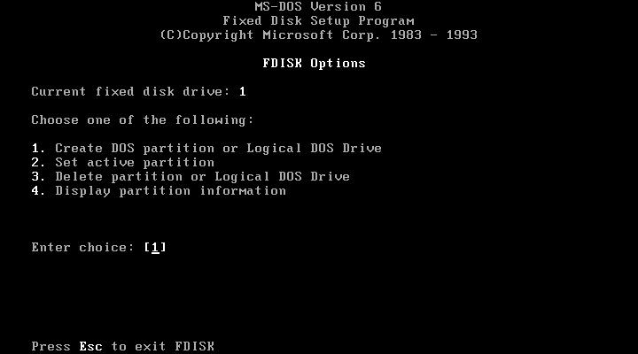
FDISK
The FDISK command-line utility provides disk-partitioning functions, preparatory to defining file systems.

Slide 18
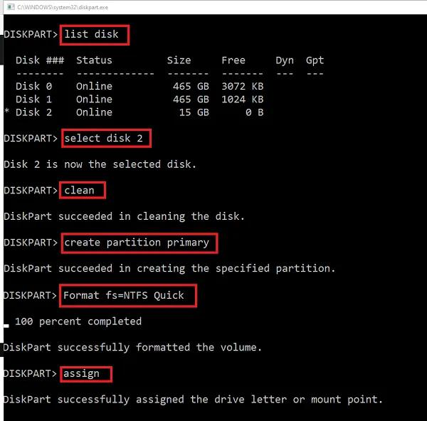
FORMAT
The format command creates a new root directory and file system for the disk. It can also check for bad areas on the disk, and it can delete all data on the disk. To be able to use a new disk, you must first use this command to format the disk.

Slide 19
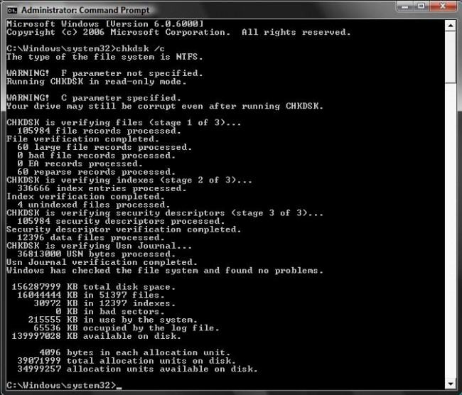
Scandisk
Microsoft ScanDisk (also called CHKDSK) is a diagnostic utility program included in MS-DOS and Windows 9x. It checks and repairs file systems errors on a disk drive, while the system starts.

Slide 20
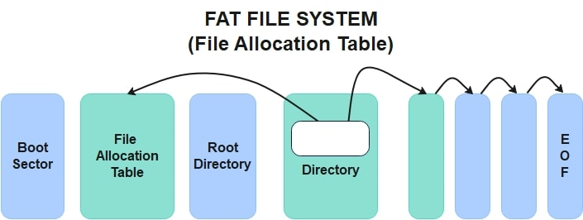
FAT SYSTEM
File Allocation Table (FAT) is a file system developed for personal computers. Originally developed in 1977 for use on floppy disks, it was adapted for use on hard disks and other devices.

Slide 21
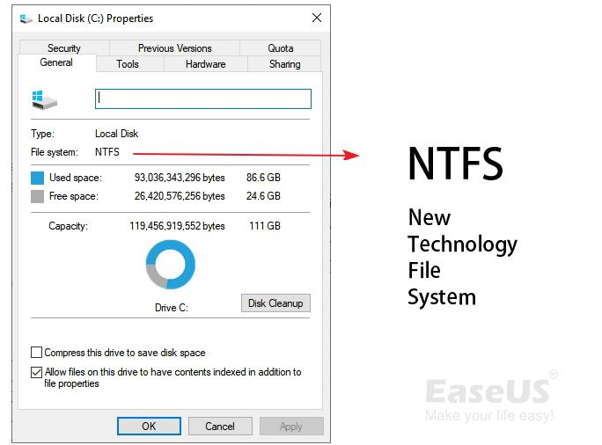
NTFS
New Technology File System is a proprietary journaling file system developed by Microsoft. Starting with Windows NT 3.1, it is the default file system of the Windows NT family. It superseded File Allocation Table as the preferred filesystem on Windows and is supported in Linux and BSD as well

Slide 22
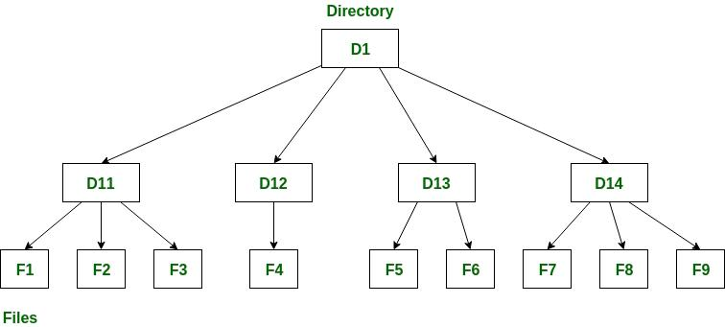
DIRECTORIES
A directory is a unique type of file that contains only the information needed to access files or other directories. As a result, a directory occupies less space than other types of files. File systems consist of groups of directories and the files within the directories.

Slide 23
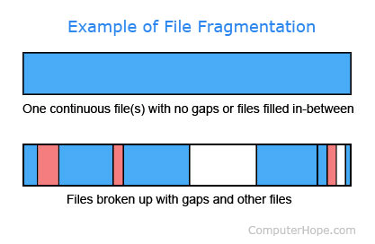
FRAGMENTATION
Disk fragmentation within a file system is an unavoidable condition. When a file is closed after it has been written to, the last logical block of data is reduced to the actual number of subblocks required, thus creating a fragmented block

Slide 24
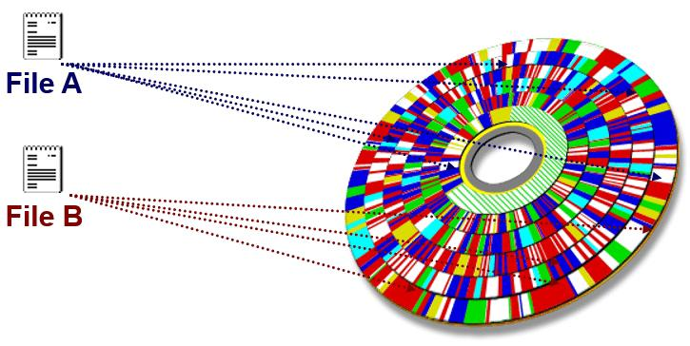
DEFRAGMENTATION
In the maintenance of file systems, defragmentation is a process that reduces the degree of fragmentation. It does this by physically organizing the contents of the mass storage device used to store files into the smallest number of contiguous regions.

Slide 25
THANK YOU

